Slide 1

Hands-Free Reading
Han Luu, Lauren Durbin, Preksha Shah

Slide 2



Meet the Team
Han Luu
Major: EE
Interest: Power systems
Preksha Ronak Shah
Major: EE
Interest: Controls, PCB
Lauren Durbin
Major: EE
Interest: Controls

Slide 3
Product Description
Purpose: Enable users to read a physical book hands-free
Vision Component: Tracks user's eye movement on page to determine when ready to flip
Robotic Component: Flip to next page when triggered by user

Slide 4

Stakeholders
Target Audience: Individuals with limited mobility or fine motor control, individuals seeking to multitask
Stakeholders:
  End users
  Caregivers/family members
  Rehabilitation centers, assisted-living facilities, etc. (accessibility-focused organizations)
  System maintainers

Slide 5
Design Constraints
Budget: total cost of materials < $425
Project duration: to be completed by April 2027
The system must have < 1 minute delay between when the eye is detected at the corner of the page and when the turning mechanism activates
  Justification: Too long of a delay will be an inconvenience for every single page flip

Slide 6
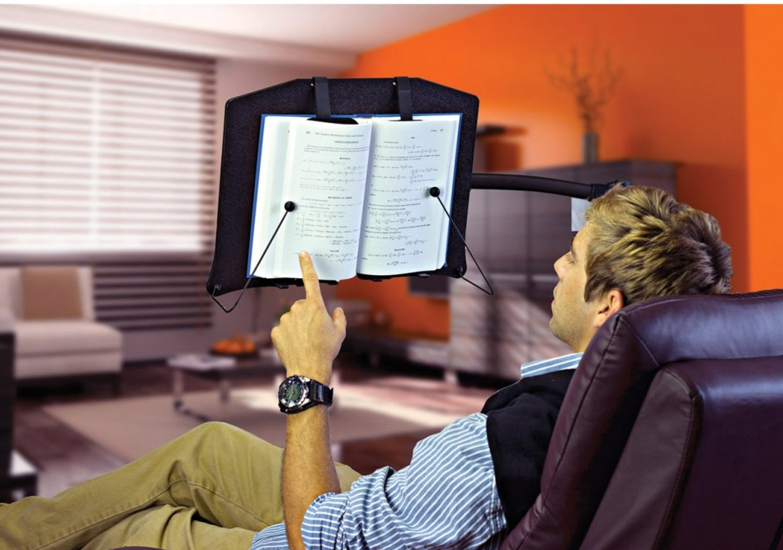
Design Requirements
Portable – size, weight, power supply
Compatibility – fit
Mostly hands-free – automated page flipper
User-friendly – features and buttons
Rechargeable - power supply
To be used in standard lighting environment – sensor
Notes:
Portable – handheld, light, easy use (no power port needed) The user needs to be able to use the product almost anywhere and in portrait orientation
Near Compatibility - Compatible with common book trims, cover types and thicknesses
Mostly hands-free - The user needs to be able to use the product entirely hands-free aside from the initial setup of the book on the holder.
Easy to use and set up
Rechargeable
To be used in standard lighting environment

Slide 7
Specifications
The product is to be used indoor, on a flat, stable surface
Product dimension: 12” x 9” with thickness to be determined
  Motivation: the two most popular book sizes have the dimension of 5"x8" and 5.5"x8.5"
Compatible with 120VAC 60Hz power supply and USB-C charging port
  Motivation: US electrical system compatibility, universal charging port
Battery for energy storage > 50 hours (buffered capacity included)
  Assuming user is a full time reader (40hrs/week) + 20% buffer as standard battery system

Slide 8
Specifications
Electronics (microcontroller, sensors, and motors) are to be powered at 5VDC
The product is to be functional in > 200 lux environment
  Motivation: Ambient lighting in a standard living room is 100-200 lux
Activation: mini camera is going to track the eye – Activate when eye is at the bottom right corner of the page
Product needs to be able to hold a novel of > 300 pages
  Motivation: Average page count of a novel is 200-400 pages

Slide 9
Complex Engineering Problem
Multiple subsystems: vision (eye-tracking), robotic (page-turning), and processing/control components must work together.
No obvious existing solution: current approaches focus on digital reading or are not truly hands-free.
Multiple stakeholder needs: the design must consider users, caregivers, and different reading situations/application scenarios
Builds on prior coursework: applies knowledge of sensors, embedded and control systems

Slide 10
New Knowledge Required
Mechanical page-flipper design
Motor-control for page-flipper
Eye-tracking system

